Slide 1

Creating a Life Insurance Dapp on the Solana Ecosystem
Discover the power of Solana blockchain technology and explore the potential of implementing a life insurance Dapp on this cutting-edge ecosystem.
wX
by wang Xing

Slide 2
Overview of Solana Blockchain Technology
High Throughput
Low Transaction Fees
With its revolutionary Proof of History consensus mechanism, Solana can process thousands of transactions per second.
Benefit from Solana's efficient architecture, allowing for cost-effective transactions on the blockchain.
Fast Confirmation Times
Smart Contract Support
Experience near-instant transaction confirmations, enabling seamless interactions on the Solana network.
Harness the power of Solana's smart contract functionality for creating complex and secure life insurance contracts.

Slide 3

Introduction to Life Insurance on the Blockchain
1
Enhanced Transparency
2
Seamless Accessibility
Utilize the immutability of blockchain to ensure transparency in claim processing and policy management.
Enable users from all around the world to access life insurance services with ease, eliminating geographical barriers.
3
Immutable Records
Create immutable records of policyholder information, reducing the risk of fraud and ensuring data integrity.

Slide 4
Features and Benefits of a Life Insurance Dapp on Solana Ecosystem
Secure & Transparent
Efficient Claims Processing
Instant Payouts
Leverage Solana's fast confirmations to enable instant payouts to policyholders in times of need.
Utilize Solana's robust security features to safeguard user data
Automate the claims process with smart contracts, reducing paperwork and improving efficiency.
Enable transparent policy details and claims processing for trust and confidence

Slide 5
Project Plan and Roadmap for Dapp Development
1
Phase 1: Research & Development
Conduct market research, define project requirements, and finalize technical specifications.
Phase 2: Smart Contract Development
2
Build robust and secure smart contracts to handle policy creation, claims, and payouts.
3
Phase 3: User Interface Design
Create an intuitive and user-friendly interface for policyholders and insurers.
Phase 4: Testing & Deployment
4
Thoroughly test the Dapp for functionality and security, and deploy on the Solana mainnet.

Slide 6

Technical Specifications and Implementation Considerations
Incorporate Solana's SPL token standard for seamless token transfers and handling premium payments.
Utilize Solana's programming language, Rust, for secure and efficient smart contract development.
Implement robust encryption and security measures to protect user data and ensure privacy.
Leverage Solana's developer tools and libraries to expedite the development process.

Slide 7
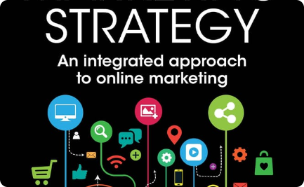


Marketing and User Acquisition Strategies
Digital Marketing
Influencer Collaborations
Social Media Advertising
Employ targeted digital marketing strategies to reach potential policyholders and create awareness about the benefits of blockchain-based life insurance.
Partner with influential figures in the insurance and blockchain space to promote the life insurance Dapp and attract a wider user base.
Utilize social media platforms to engage with the community, share success stories, and showcase the advantages of the Dapp.

Slide 8

Conclusion and Future Scope of the Project
1
Enabling Financial Inclusion
2
Expanding to Other Insurance Verticals
By leveraging Solana's technology, we can facilitate access to life insurance for the unbanked population, promoting financial inclusion.
Once the life insurance Dapp is successfully implemented, the Solana ecosystem opens doors for expansion into other insurance verticals, such as health or property insurance.
3
Driving Innovation in Insurance
By combining blockchain and insurance, we can drive innovation in the industry, creating new opportunities for insurers and policyholders.

